Slide 1
Solving linear equations
Year 7
Week 6
Lesson 1

Slide 2
First 5 questions
( 4 + 5 ) x ( 2 – 1 ) =
What is the mean for the following: 3, 1, 5, 4, 7, 9
Simplify the following ratio, 9: 99 =
What is 25% of $40
X + 2 = 5, state what the expression is

Slide 3
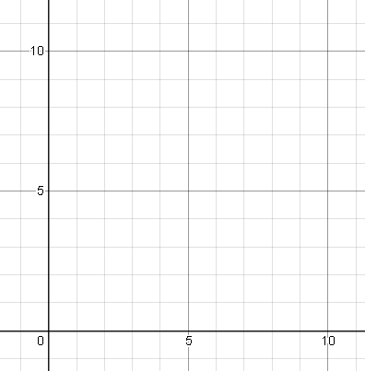
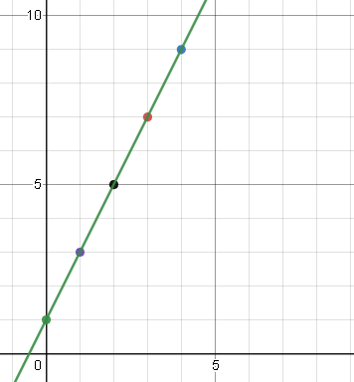
Graphing (demonstration)
EQ: How do you graph a linear equation on the cartesian plane?
Using the following rule, Y = 2x + 1, complete the below table.
Once completed plot it on the cartesian plane.
How do we graph points from a table?
X | 0 | 1 | 2 | 3 | 4
Y

Slide 4
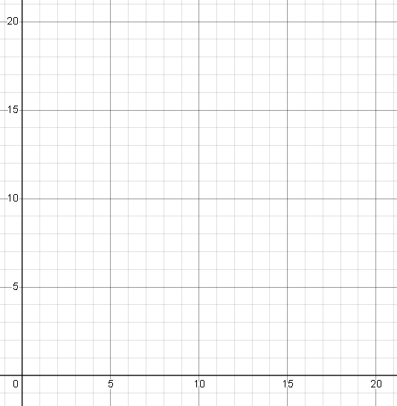
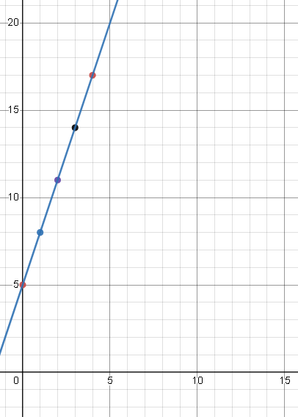
Graphing (demonstration)
EQ: How do you graph a linear equation on the cartesian plane?
Using the following rule, Y = 3x + 5, complete the below table.
Once completed plot it on the cartesian plane.
X | 0 | 1 | 2 | 3 | 4
Y

Slide 5
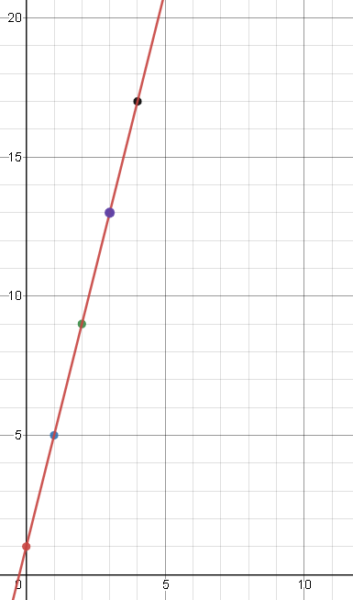
Graphing (your turn)
EQ: How do you graph a linear equation on the cartesian plane?
Using the following rule, Y = 4x + 1, complete the below table.
Once completed plot it on the cartesian plane.
X | 0 | 1 | 2 | 3 | 4
Y

Slide 6
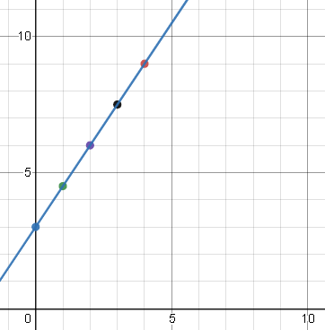
Graphing (your turn)
EQ: How do you graph a linear equation on the cartesian plane?
Using the following rule, Y = 1.5x + 3, complete the below table.
Once completed plot it on the cartesian plane.
X | 0 | 1 | 2 | 3 | 4
Y

Slide 7
Practice questions
Use the following rules and graph them on the worksheets provided
  Qn.1 Y = 2x – 2
  Qn.2 Y = -x
  Qn.3 Y = 0.5x – 1
  Qn.4 Y = 3x + 2
  NOTE: create the table first.

Slide 9
Solving worded linear equations
Year 7
Week 6
Lesson 2

Slide 10
First 5 questions
( 93 – ( 1 + 8 ) ) x 2 =
What is the mean and mode for the following: 3, 1, 2, 7, 4, 7, 9
Simplify the following ratio, 12: 144 =
What is 30% of $80
X + 2 = 5, state what the terms are

Slide 11
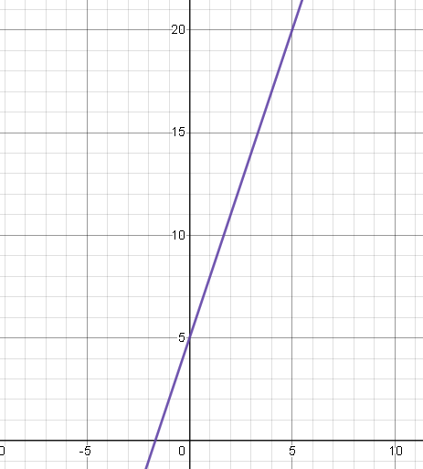
Graphing (demonstration)
EQ: How do you graph a linear equation from worded question?
Ever since Renata moved to her new home, she's been keeping track of the height of the tree outside her window.
Y represents the height of the tree (in cm), X represents years since Renata moved in.
Y = 5 + 3X
How fast does the tree grow per year?
Answer = 3cm per year
How do we graph a linear equation from a worded question?
X | 0 | 1 | 2 | 3 | 4
Y

Slide 12
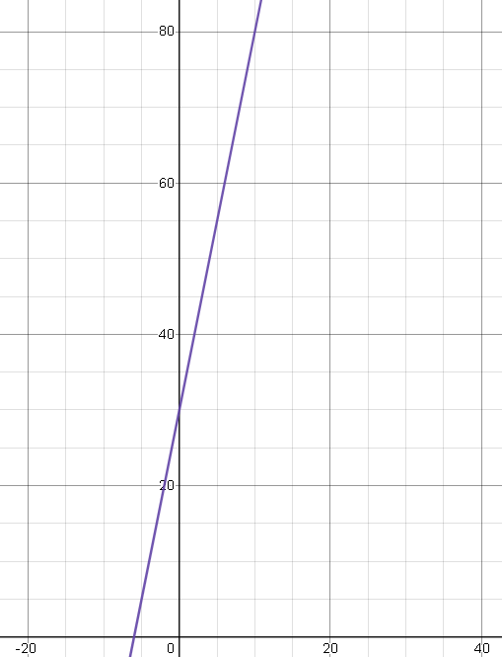
Graphing (demonstration)
EQ: How do you graph a linear equation from worded question?
A young sumo wrestler decided to go on a special diet to gain weight rapidly.
Y represents the wrestler's weight (in kilograms) and X represents the time (in months).
Y = 5x + 30
How much weight does the wrestler gain every 2 months?
Answer = 10kg per 2 months
X | 0 | 1 | 2 | 3 | 4
Y

Slide 13
Practice questions - worksheet
Answer the questions on the provided worksheets
We will go through them together before the end of the lesson.

Slide 15
Balancing equations
Year 7
Week 6
Lesson 3

Slide 16
First 5 questions
( 4 + 5 ) x ( 5 – 2 ) =
What is the mean and median for the following: 3, 2, 1, 5, 13, 4, 7, 9, 11
Simplify the following ratio, 5 : 35 =
What is 75% of $28
3x + 2 = 5, state the coefficient and variable

Slide 17
Graphing (demonstration)
EQ: How do we balance equations?
When we try to balance an equation, we make sure both sides of the scale are balanced, for example, when tackling the below question..
How do we approach balancing equations?
x + 2 = 4
-2
X
1
1
1
1
1
1

Slide 18
Graphing (demonstration)
EQ: How do we balance equations?
When we try to balance an equation, we make sure both sides of the scale are balanced, for example, when tackling the below question.
How do we approach balancing equations?
2
4
x + + 2 = 4
-2
-2
X
1
1
1
1

Slide 19
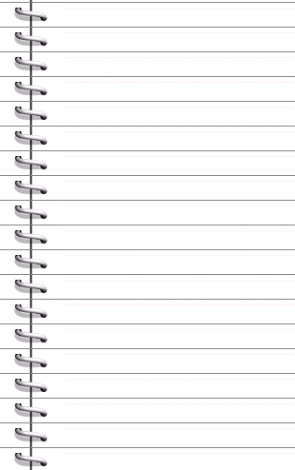
Graphing (demonstration)
EQ: How do we balance equations?
When showing working, make sure to show what you are doing on both sides of the equation, as shown below.
x
+
3
=
5
x + 3 = 5
-3
-3
x = 2
1
1
1
1
1
1
1
x
1

Slide 20
Equations – Keep it balanced…
2x + 1 = 3
2
x
+
1
=
3
-1
-1
2x = 2
÷2
÷2
x = 1
x
x
1
1
1
1

Slide 21
Equations – Keep it balanced…
3x + 2 = 8
3
x
+
2
=
8
-2
-2
3x = 6
÷3
÷3
x
1
1
x = 2
x
x
1
1
1
1
1
1
1
1

Slide 22
Solving Equations
In your books, find what the x value is for the following
4
x
+
10
=
18
2
x
+
9
=
19
x
+
22
=
50
3
x
+
4
=
19
3
x
+
4
=
1

Slide 23
Solving Equations
In your books, find what the x value is for the following
2
x
12
=
18
-
2
x
9
=
7
-
x
8
=
10
-
3
x
4
=
17
-
4
x
4
=
-12
-
When finished, complete your summary.

